Slide 1


Mechanical Drivetrains
Team 4: Sliding bearings in gearboxes of WEC
Presented by: Matriculation No.
Hassan Pour Saeid 730257
Mozafary Mostafa 750247
Mahmoud Abdelwadood 740163
Patel Manthan 750301
Patil Rahul 750532
Soni Karan 760153
Guided by: Prof. Hans Kyling
Date : 24.05.2024
Place: Flensburg

Slide 2
Overview
Fundamentals of operation
Variants and design of sliding bearings
Design requirements
Concepts and solutions in drivetrains (gearboxes) of WEC
Pros and cons compared to alternative solutions
Rotor bearing applicability
Current challenge
Summary and outlook
Supplementary video
References

Slide 3
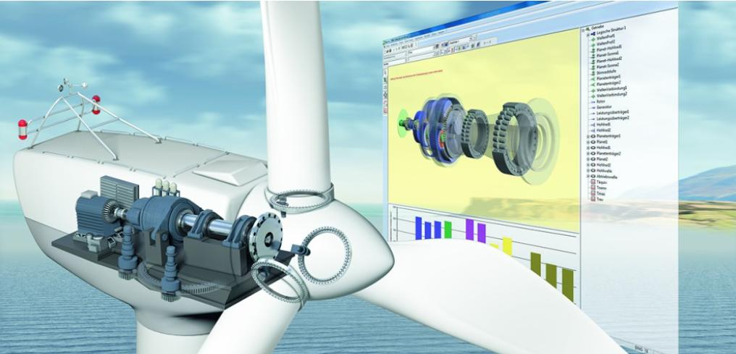
1. Fundamentals of operation
Figure 1.1: Location of Bearings [Source: Schaeffler]
Nowadays, bearings are used widely in different parts of wind turbines. (main shaft, yaw system, pitch system, generator and gearbox)

Slide 4
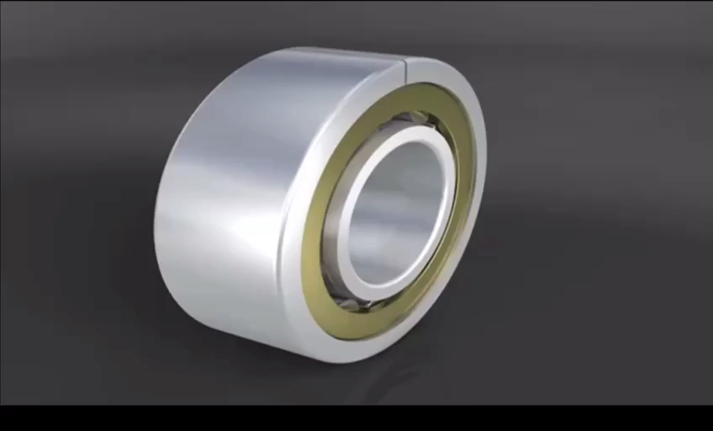
1. Fundamentals of operation
IEC 61400-4 prepared standards to follow. In general, due to considered life time for wind turbine (20 years or more) so, all components include bearings should tolerate for this life span. [1]
Specific bearings are needed in each application. For instance: in generator due to current passage, Current-insulating bearings are commonly used
Video 1.1 : EDM In Bearings
(Source :scheaffler)

Slide 5
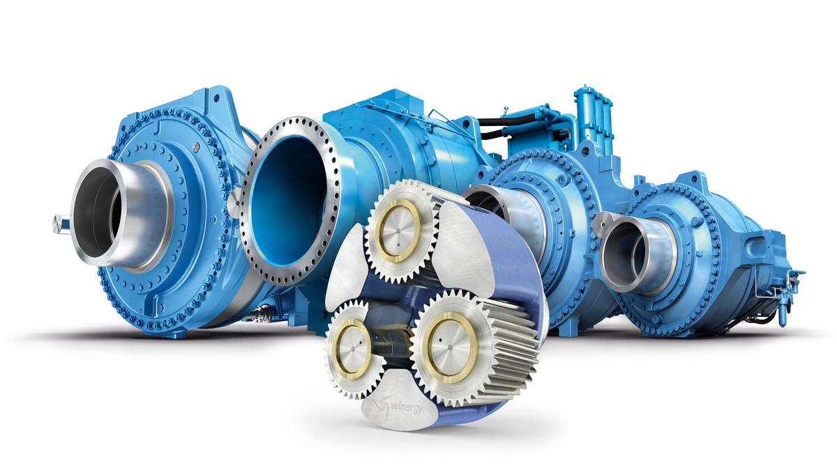
1. Fundamentals of operation
Figure 1.2: Gearbox [Source: Windergy]
But what about WT Gearbox!!? Which type of bearings are using in wind turbine gearbox?

Slide 6
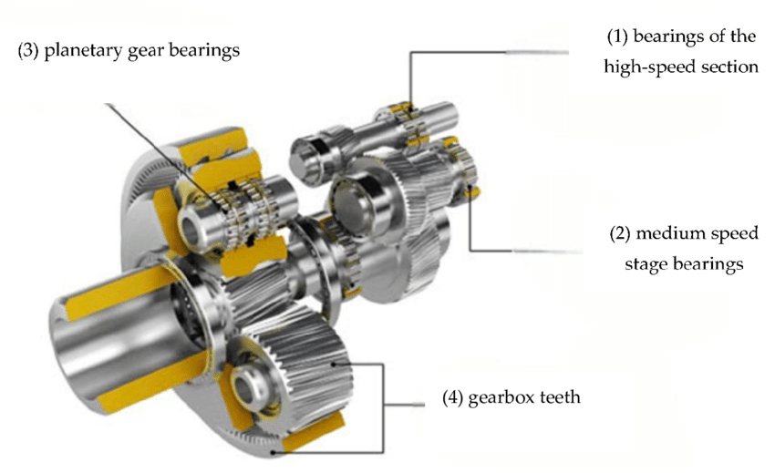
1. Fundamentals of operation
Roller bearings and sliding bearings both are used but, The use of sliding bearings instead of rolling bearings in planetary gearbox makes it possible to increase the power density with lower component costs and higher reliability. Therefore, the use of planet gear sliding bearings in wind turbine gearboxes has become more common.[2]
Figure 1.3: Planetary gear Bearings [Source: Schaeffler]

Slide 7
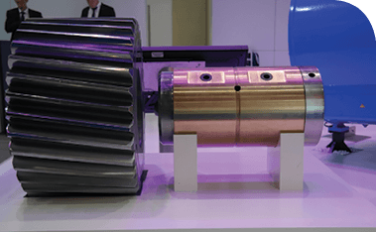
1. Fundamentals of operation
Concept:
Just bearing surface and no rolling elements.
Sliding surface is separated by lubricating film. (To reduce friction, wear and heat)
Sliding bearing applications are generally under low-speed and heavy load conditions.
Boundary lubrication reduces wear and friction
Figure 1.4: Sliding Pin bearing [Source: Winergy]

Slide 8
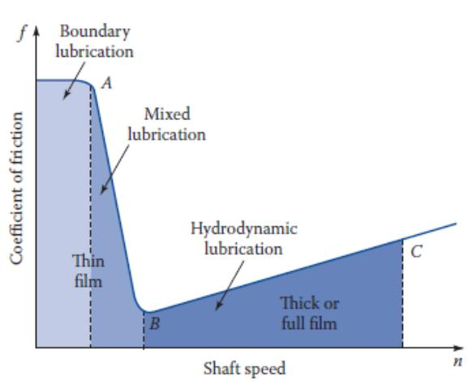
1. Fundamentals of operation
Types of lubrication:
Lubricants may be Liquid, solid or gas.
Five types of lubrication occur in bearings. (boundary, mixed, elasto-hydrodynamic, hydrodynamic and hydrostatic)
Hydrodynamic Lubrication: coefficient of friction from 0.002 to 0.010.
Mixed lubrication: coefficient of friction from 0.004–0.10
Boundary: coefficient of friction is about 0.1
Elasto-hydrodynamic: lubrication is concerned with the interrelation between the hydrodynamic action of full-fluid films and the elastic deformation of the supporting materials.
Hydrostatic: Fluid pressure is created by external.[3]
Figure 1.5: coefficient of friction (f) with shaft speed [Source: 3]

Slide 9
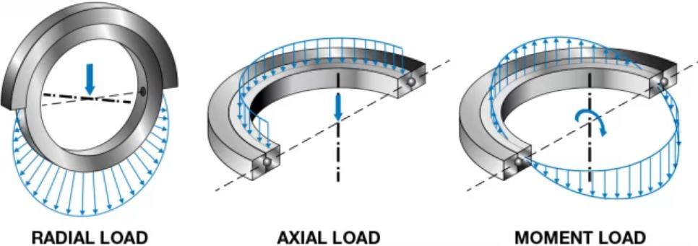
1. Fundamentals of operation
The first step in selecting the correct bearing for a given application is to calculate the loads that the bearing will be subjected.
Four types of loads in bearings:
Radial loads
Axial loads
Moment loads
combined loads
Figure 1.6: Types of loads in bearing [Source: FHD Bearing]

Slide 10
2. Variants and design of sliding bearings
Classification of Sliding Contact Bearing
Based on the type of load carried
Based on the type of lubrication
Based on the type of lubrication Mechanism
Radial Bearing
Thrust Bearing
Thick film lubrication
Thin-film lubrication
Boundary lubrication
Hydrodynamically lubricated bearings
Hydrostatic lubricated bearings
Electrohydrodynamic lubricated bearings
Boundary lubricated bearings
Solid film lubricated bearings

Slide 11
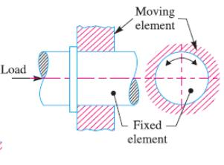
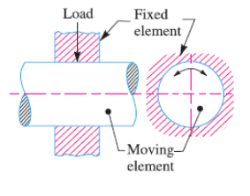
2. Variants and design of sliding bearings
Journal Bearings :
Thrust Bearings :
Load acts perpendicular to the direction of the motion.
Load acts along the direction of the motion.
Figure 2.1: Journal Bearing [Source: 4]
Figure 2.2: Thrust Bearing [Source: 4]

Slide 12
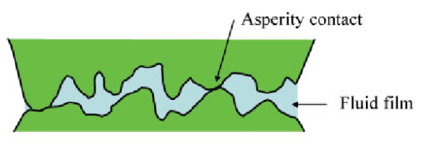
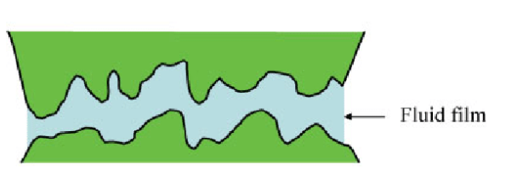
2. Variants and design of sliding bearings
Thick Film Bearing :
In the thick film bearings are those in which the working surface are complete separated from each other by the lubricant. Such type of bearings are also called hydrodynamic lubricated bearing.
Viscous Fluid separates the element with a thickness of 8mm to 20mm. [5]
Thin Film Bearing :
In the thick film bearings are those in which, although lubricant is present, the working surfaces partially contact each other at least part of the time. Such type of bearings are also called Boundary lubricated bearing.
Due to the thin layer of lubrication is presented, there are intermittent contacts between rolling and fixed elements.
Coefficient of friction is between 0.004 to o.10 [5]
Figure 2.3: Thick Film Bearing [Source: 5]
Figure 2.4: Thin Film Bearing [Source:5]

Slide 13
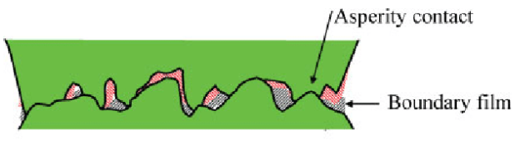
2. Variants and design of sliding bearings
Solid Film lubrication Bearing :
In the Boundary lubrication bearings are those in which the working surface are directly contacted with each other without any lubricant. Such type of bearings are also called Zero Film bearing.
Coefficient of Friction is between 0.05 to 0.20. [5]
Figure 2.5: Solid Film Lubrication Bearing [Source: 5]

Slide 14
3. Design requirements
Bearing Selection procedure:
Confirm operating conditions of bearing and consider bearing type
Select bearing dimensions
Select bearing tolerances
Select bearing internal clearance
Select cage
Select lubrication method
Consider special specification
Select installation and disassembly procedures
[Source: 06]

Slide 15
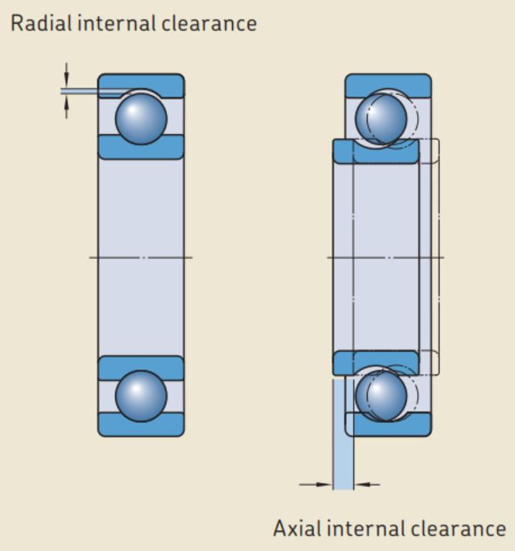
3. Design requirements
Axial and radial guidance of the rotor
Axial clearance: It also contributes to minimizing local maximum pressures.
Radial Clearance: Proper radial clearance helps reduce maximum pressures occurring at the bearing edges. [7]
Transferring dynamic and static loads of the rotor
The bearing must handle both static and dynamic loads without failure.
Gives more Stability, Performance and safety [8]
Stand still loads
Stand still loads means forces and loads that act on the bearing when it is not in motion.
In order to tackle this issue pressurised rise lubrication film must be produced with the help of pumping machine.
Figure: 3.1: Axial and Radial Clearance [Source: SLS Bearings]

Slide 16
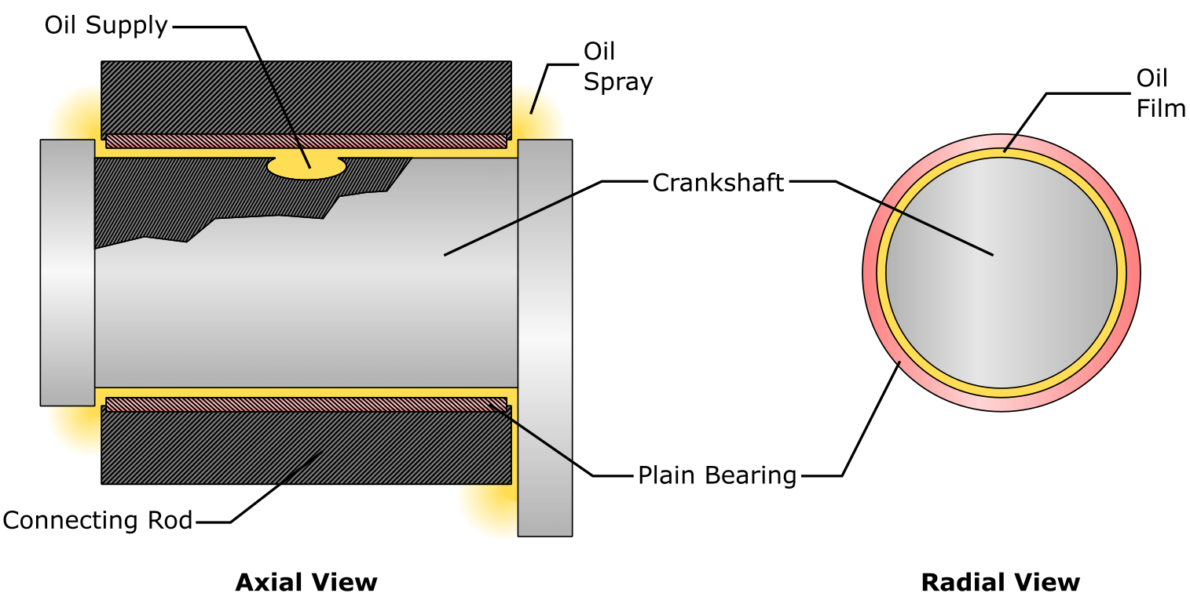
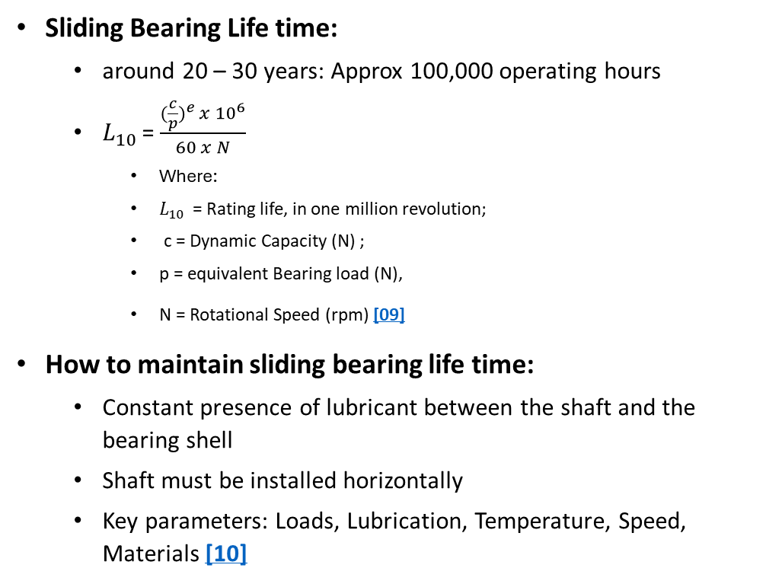
3. Design requirements
Sliding Bearing Life time:
around 20 – 30 years: Approx 100,000 operating hours
$L_{10 }$= $\frac{{(\frac{c}{p})}^{e} x {10}^{6}}{60 x N}$
Where:
$L_{10 }$= Rating life, in one million revolution;
c = Dynamic Capacity (N) ;
p = equivalent Bearing load (N),
N = Rotational Speed (rpm) [09]
How to maintain sliding bearing life time:
Constant presence of lubricant between the shaft and the bearing shell
Shaft must be installed horizontally
Key parameters: Loads, Lubrication, Temperature, Speed, Materials [10]
Figure 3.2 : Lubrication Journal bearing [Source: SAVREE Plain Bearings]

Slide 17
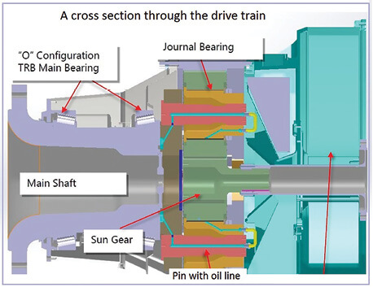
3. Design requirements
Factors affecting the design of sliding bearings:
Viscosity of lubricant
Rubbing speed/ relative speed between bearing and journal
Specific pressure
Heat dissipation
Provision of cooling
Selection of lubrication and its quantity
Selection of bearing material [11]
Figure 3.3: One goal for the next-gen gearbox is to boost drivetrain efficiency. [Source: Windpowerengineering]

Slide 18
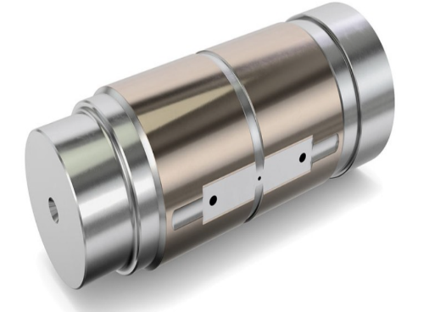
4. Concepts and solutions in drivetrains
1. Schaeffler Hydrodynamic Plain
higher power density in compact spaces.
These bearings feature a thin bronze sliding layer
Chemical bonding between the journal and sliding layer ensures long-term durability, allowing for decades of operation. [12]
2. RENK - Slide bearings used in improved gearbox design
Can support moderate axial forces in addition to high radial forces [13]
Figure 4.1: Schaeffer Plain Bearing [Source: Schaeffler]

Slide 19
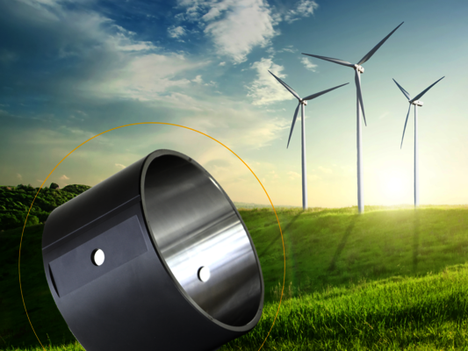
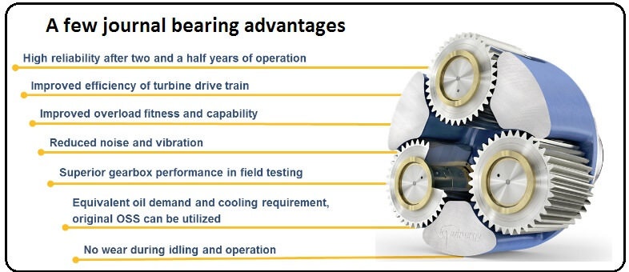
4. Concepts and solutions in drivetrains
3. Winergy Journal bearing
High reliability
Low noise and vibration
Optimized efficiency at lower costs [14] Higher load capacity
Figure 4.3: MIBA Plain bearing [Source: MIBA]
4. MIBA hydrodynamic plain bearing
Higher power density
Longer services life due to hydrodynamic operation
Higher load capacity
Higher impact resistance
Reduction of the install spaces
Weight and noise reduction [15]
Figure 4.2: Journal Bearing Advantages [Source: Winergy]

Slide 20
5. Pros and cons compared to alternative solutions
Roller bearings (CRB, SRB, TRB) are often used in the gear box of the WEC. [16]
Characteristics | Sliding Bearing | Roller bearing
Noise | Practically noiseless | Noise at resonance level
Life | Higher | Definite life due to fatigue loading
Cost | Less | High
Starting torque | High | Low
Space | Very less | High
Assembly | Easy | Difficult
Weight | Light | Heavy
Table 5.1: Advantages of Sliding bearing compared to the Roller bearing [4]

Slide 21
5. Pros and cons compared to alternative solutions
Characteristics | Sliding Bearing | Roller bearing
Failure | Sudden failure | Abnormal sound before failure
Design | Complex | Easy
Clearances | More | Less
Maintenance | Greater care | No special care
Lubrication | High quantity | Low quantity
Load Steady Starting Shock | Good Poor Satisfactory | Very Good Very Good Good
Table 5.2: Disadvantages of Sliding bearing compared to the Roller bearing [4]

Slide 22
6. Rotor bearing applicability
Currently every OEM uses SRB as Main Bearing but application of sliding bearing in wind turbine rotor can be an alternative due to given reasons.
Simple and cost Effective
Less Noise and Vibrations
Greater durability and longer life
Higher Load bearing capacity
Contaminant tolerance is high
But with some advantages it has some serious disadvantages associated with it such as:
High friction losses
High Wear
Greater Heat Generation
Difficulty in lubrication
Precise alignment

Slide 23
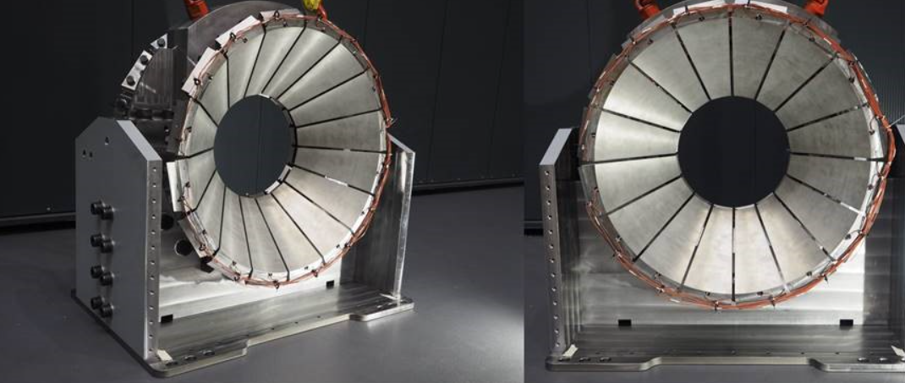
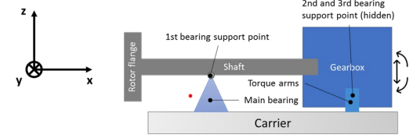
6. Rotor bearing applicability
There are some investigations are going on to implementation of plain bearing as a Main rotor bearing such as:
1. Flex Pad segment plain bearing for 8.5 MW Wind turbine [17][18][19]
2. Feasibility study for the use of hydrodynamic plain bearings with balancing support characteristics as main bearing in wind turbines [20]
Figure 6.1 : FlexPad: Conical (v-shaped) sliding bearing for the wind turbine main bearing ( Source RWTH Innovation GmbH]
Figure 6.2 : Schematic sketch of a drivetrain in three-point suspension [20]

Slide 24
6. Rotor bearing applicability
Conclusion of applicability:
Plain bearings as a main bearing is a viable option, but it necessitates meticulous attention to design specifications, lubrication strategies, and maintenance protocols to ensure dependable performance.
Progress in bearing materials and lubrication techniques continues to broaden their applicability in these contexts.
Plain bearings can be an option, particularly in larger, slower-moving turbines where their advantages in handling high loads and durability can be beneficial.

Slide 25

7. Current challenge
Recent developments in the mechanical drive train of wind power plants have highlighted several key challenges:
1. Gearbox Reliability and Failures:
Despite improvements, gearboxes still face significant reliability issues due to complex load conditions, lubrication problems, and material fatigue. Advanced monitoring systems and enhanced materials are critical to addressing these challenges. [21]
2. Bearing Failures:
Bearings frequently fail prematurely due to White Etching Cracks (WEC) and contamination. Enhanced lubrication systems and new bearing designs are being explored to increase durability. [22]
Video 7.1 : Exchange of planet carrier bearing by Winergy
( Source : https://www.youtube.com/watch?v=-2m80nuC5-g )

Slide 26
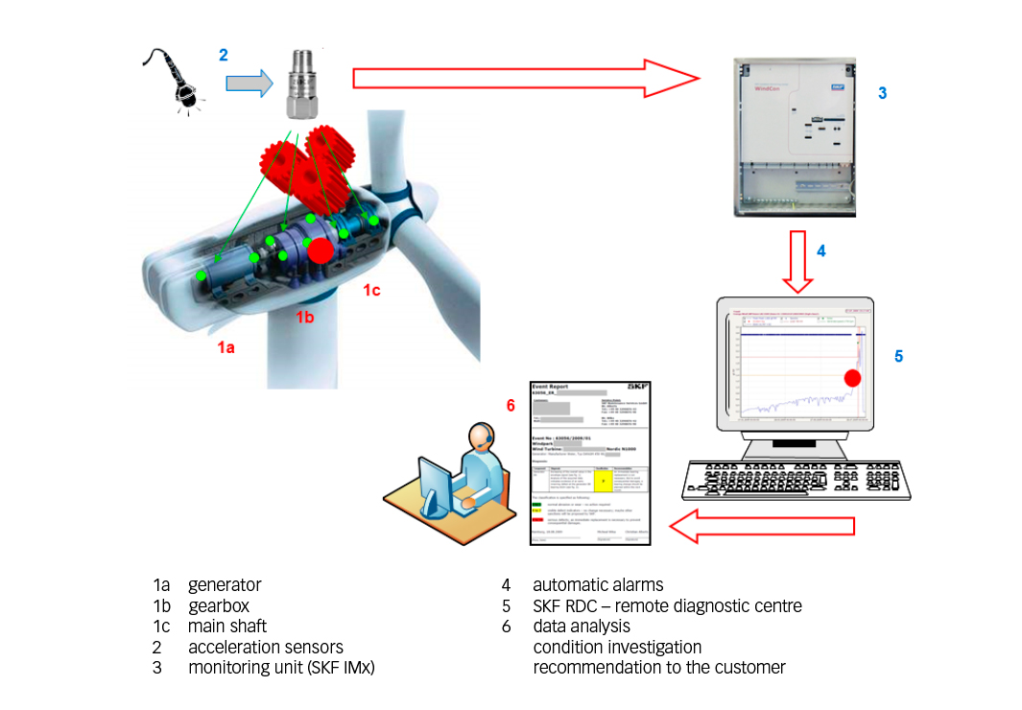
7. Current challenge
3. Structural Vibrations and Resonance:
The drive train is prone to vibrations and resonance, leading to component fatigue and failure. Improved damping techniques and robust design standards are essential to mitigate these effects. [23]
4. Condition Monitoring and Predictive Maintenance:
Integrating sophisticated condition monitoring systems and predictive maintenance strategies is crucial for early fault detection and prevention of catastrophic failures.[24]
Figure 7.1 : Noise and vibration monitoring in WT bearings [Source : SKF]

Slide 27
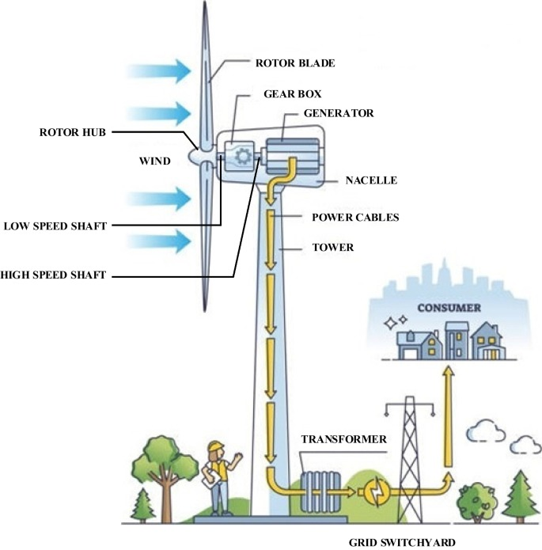
7. Current challenge
5. Grid Integration and Load Management:
Efficient handling of variable loads is vital for wind power's dynamic nature. Innovations in control systems and grid integration are being developed to stabilize performance under fluctuating conditions.[24]
6. Materials and Manufacturing Technologies:
Advancements in materials science, such as high-strength composites and improved steel alloys, enhance the durability and performance of drive train components.[22]
Figure 7.2 : Large-scale wind power grid integration [Source : 25]

Slide 28
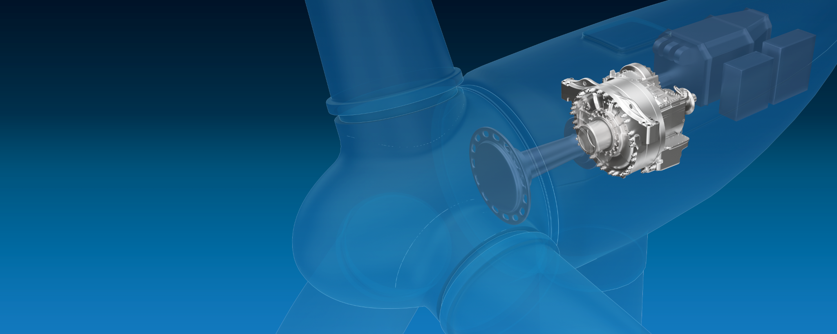
8. Summary and Outlook
Roller bearings and sliding bearings both are used but, The use of sliding bearings instead of rolling bearings in planetary gearbox makes it possible to increase the power density with lower component costs and higher reliability. [2]
Figure 8.1 : Wind turbine Gearbox [Source : ZF]

Slide 29
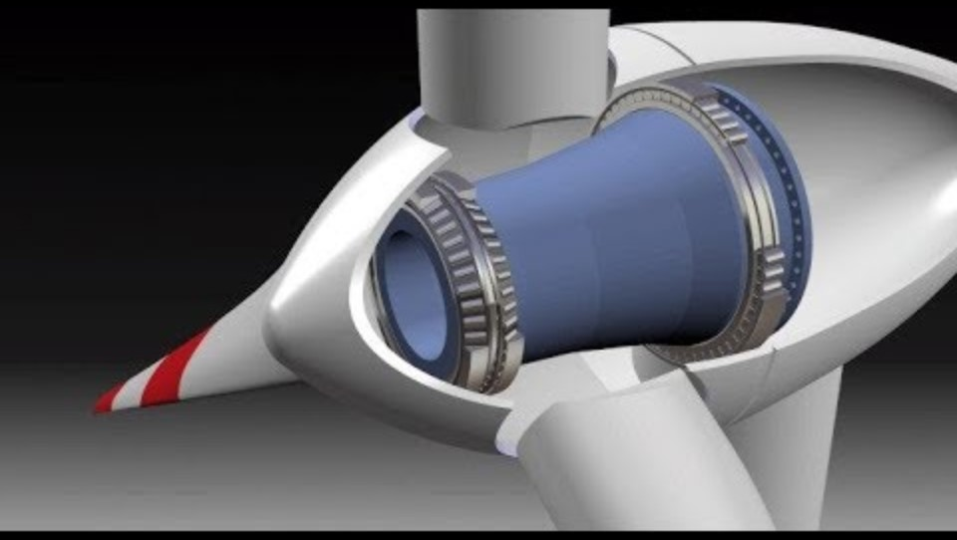
9. Supplementary Video
[Source : https://youtu.be/PRjoDjXN1cI?si=F_rC3rrHbwQKk2mS]

Slide 30
10. References
IEC 61400-4:2012 Design requirements for wind turbine gearboxes [1]
Ding, H.; Mermertas, Ü.; Hagemann, T.; Schwarze, H. Calculation and Validation of Planet Gear Sliding Bearings for a Three-Stage Wind Turbine Gearbox. Lubricants 2024, 12, 95.[2]
Uobabylon : https://www.uobabylon.edu.iq/eprints/publication_7_4218_752.pdf [3]
Mistry, G. (s.d.). Fundamental and selection of bearings. Tratto da slideshare: https://www.slideshare.net/GauravMistry14/fundamental-and-selection-of-bearings [4]
Yu Yan, A. N. (2010). Electrochemical Instrumentation of a Hip Simulator: A New Tool for Assessing the Role of Corrosion in Metal-On-Metal Hip Joints [5]
Technical Data. 2. Bearing Selection, and shaft and housing design : PrecisionBrgs-e-005.pdf ntn.co.jp [6]
MALCOLM E. LEADER, P. (s.d.). A Practical Guide To Rotor Dynamics. Applied Machinery Dynamics Company. [7]
NAMICS Technologies: namics-corp.com [8]
American Roller Bearing company. Bearing, Loads & speeds. Retrieved from Bearing Life Calculation - Bearing Loads & Speeds | American Roller Bearing (amroll.com) [9]
GLOBAL BEARING TECHNOLOGIES S.R.L. (2024, May 10). Unlocking the Significance of Bearing Life Cycle and Its Calculations [10]
Fundamental and selection of bearings : slideshare.net [11]
Schaeffler: https://www.schaeffler.de/en/news_media/press_releases/press_releases_detail.jsp?id=[12]
RENK: Slide Bearing – RENK [13]
Winergy :https://www.winergy-group.com/en/journal-bearing [14]

Slide 31
10. References
Miba: https://www.miba.com/en/product-areas/bearings/plain-bearing-vs-roller-bearing-benefit-from-an-upgrade-from-roller-bearing-to-plain-bearing-miba [15]
Paul Dvorak. What different kinds of bearings are used in wind turbines?: What different kinds of bearings are used in wind turbines? (windpowerengineering.com) [16]
Jan Euler, Georg Jacobs, Amin Loriemi, Timm Jakobs, Amadeus Rolink, Julian Rouder (27.October 2023). ‘Scaling Challenges for Conical Plain Bearings as Wind Turbine Main Bearings’ : https://www.mdpi.com/2674-032X/3/4/27 [17]
Amadeus Rolink, Georg Jacobs, Tim Schrouder, Dennis Keller, Timm Jakobs, Dennis Bosse, Jochen Lang, Gunter Knoll (18.February.2021). Springer: ‘Methodology for the systematic design of concal bearings for use as main bearings in wind turbines’. [18]
RWTH Innovation GmbH. ‘FlexPad: Conical (V-shaped) sliding bearing for the Wind Turbine main bearing’. [19]
Amadeus Rolink, Tim Schrouder, Georg Jacobs, Dennis Bosse, Johannes Hoelzl, Philipp Bergmann. RWTH Aachen University: ‘Feasibility study for the use of hydrodynamic plain bearings with balancing support characteristics as main bearing in wind turbines’. [20]
Gaertner, E. A., et al. (2020). "Wind turbine drivetrains: state-of-the-art technologies and future development trends." Wind Energy Science, 5, 1401-1423. [21]
Feng, Y., et al. (2021). "Robust fault estimation for wind turbine pitch and drive train systems." ScienceDirect.[22]
NREL (2023). "Wind turbine drivetrain condition monitoring and wind plant reliability research.“ [23]
Gaertner, E. A., et al. (2020). Wind Energy Science. [24]
Mastoi, M.S., Zhuang, S., Haris, M. et al. Large-scale wind power grid integration challenges and their solution: a detailed review. Environ Sci Pollut Res 30, 103424–103462 (2023). https://doi.org/10.1007/s11356-023-29653-9 [25]
Scheaffler :- https://www.schaeffler.de/en/products-and solutions/industrial/industry_solutions/wind_sector_cluster/wind/generator/)

